Slide 2
What is jQuery?
jQuery is a lightweight, "write less, do more", JavaScript library.
The purpose of jQuery is to make it much easier to use JavaScript on your website.
jQuery takes a lot of common tasks that requires many lines of JavaScript code to accomplish, and wraps it into methods that you can call with a single line of code.
jQuery also simplifies a lot of the complicated things from JavaScript, like AJAX calls and DOM manipulation.
The jQuery library contains the following features:
HTML/DOM manipulation
CSS manipulation
HTML event methods
Effects and animations
AJAX
Utilities

Slide 3
Adding jQuery to Your Web Pages
There are two versions of jQuery available for downloading:
Production version - this is for your live website because it has been minified and compressed
Development version - this is for testing and development (uncompressed and readable code)
Both versions can be downloaded from jQuery.com.
The jQuery library is a single JavaScript file, and you reference it with the HTML <script> tag (notice that the <script> tag should be inside the <head> section):
<head> <script src="jquery-1.8.3.min.js"></script> </head>
Tip: Place the downloaded file in the same directory as the pages where you wish to use it.

Slide 4
jQuery Syntax
The jQuery syntax is tailor made for selecting HTML elements and perform some action on the element(s).
Basic syntax is:
$(selector).action()
A $ sign to define/access jQuery
A (selector) to "query (or find)" HTML elements
A jQuery action() to be performed on the element(s)
Examples:
$(this).hide() - hides the current element.
$("p").hide() - hides all <p> elements.
$(".test").hide() - hides all elements with class="test".
$("#test").hide() - hides the element with id="test".

Slide 5
The Document Ready Event
You might have noticed that all jQuery methods in our examples, are inside a document ready event:
$(document).ready(function(){ // jQuery methods go here... });
This is to prevent any jQuery code from running before the document is finished loading (is ready).
Tip: The jQuery team has also created an even shorter method for the document ready event:
$(function(){ // jQuery methods go here... });

Slide 6
jQuery Selectors
All type of selectors in jQuery, start with the dollar sign and parentheses: $().
The element Selector
Example
When a user clicks on a button, all <p> elements will be hidden:
$(document).ready(function(){ $("button").click(function(){ $("p").hide(); }); });

Slide 7
The #id Selector
The jQuery #id selector uses the id attribute of an HTML tag to find the specific element.
An id should be unique within a page, so you should use the #id selector when you want to find a single, unique element.
To find an element with a specific id, write a hash character, followed by the id of the element:
$("#test")
Example
When a user clicks on a button, the element with id="test" will be hidden:
$(document).ready(function(){ $("button").click(function(){ $("#test").hide(); }); });

Slide 8
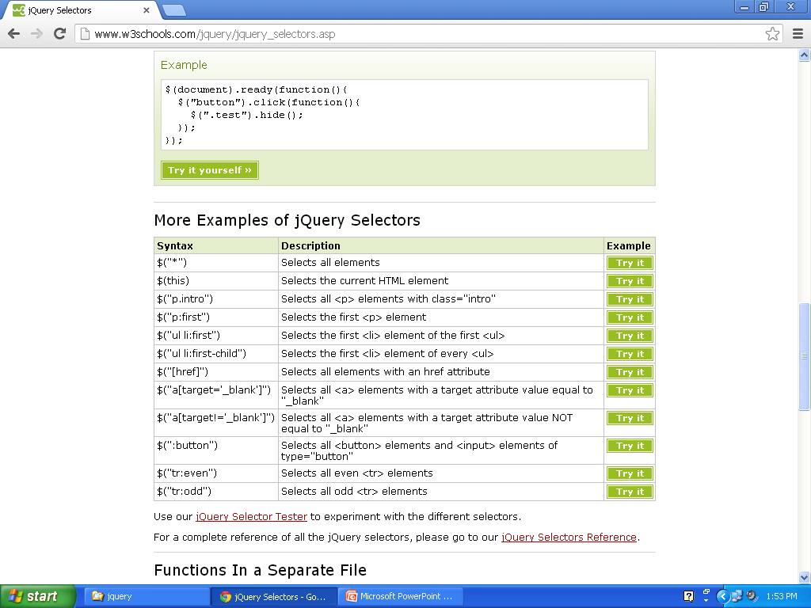

Slide 9
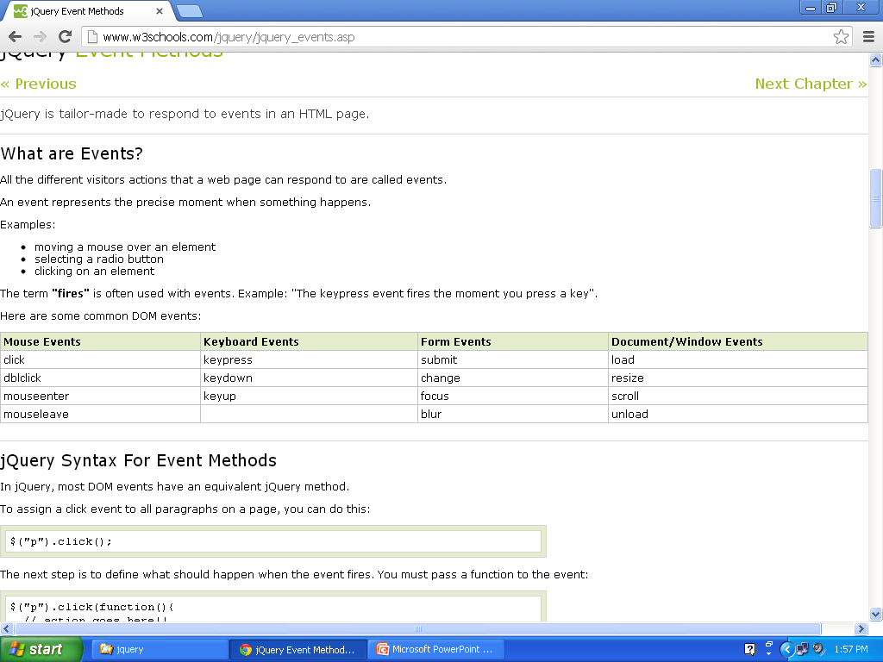
jQuery Event Methods

